Slide 1
Blogging Site
Prashansa Priya
LLID:prapriya3​​

Slide 2

About this site
This site is basically a blogging platform where we ​are allowed to go through the posts available in this site of our interests and even pen down our thoughts upon any topic of our interests or anything we are skilled at like any recipe , any experience which we had after any event or incident, educational content and many more . Making it extremely user friendly , by providing options for users to easily access the the various features of this site.

Slide 3
Features available
Allows to read others’ posts and even we can like or comment on those.
Allows to create posts
Allows to Edit and delete posts created by you
Searching any posts of your interest
Filtering posts category wise

Slide 4






Tech Used:
React. js
Tailwind framework
Javascript
Formik- and Yup
Redux and Redux-thunk
React-router-dom
React-toastify

Slide 5
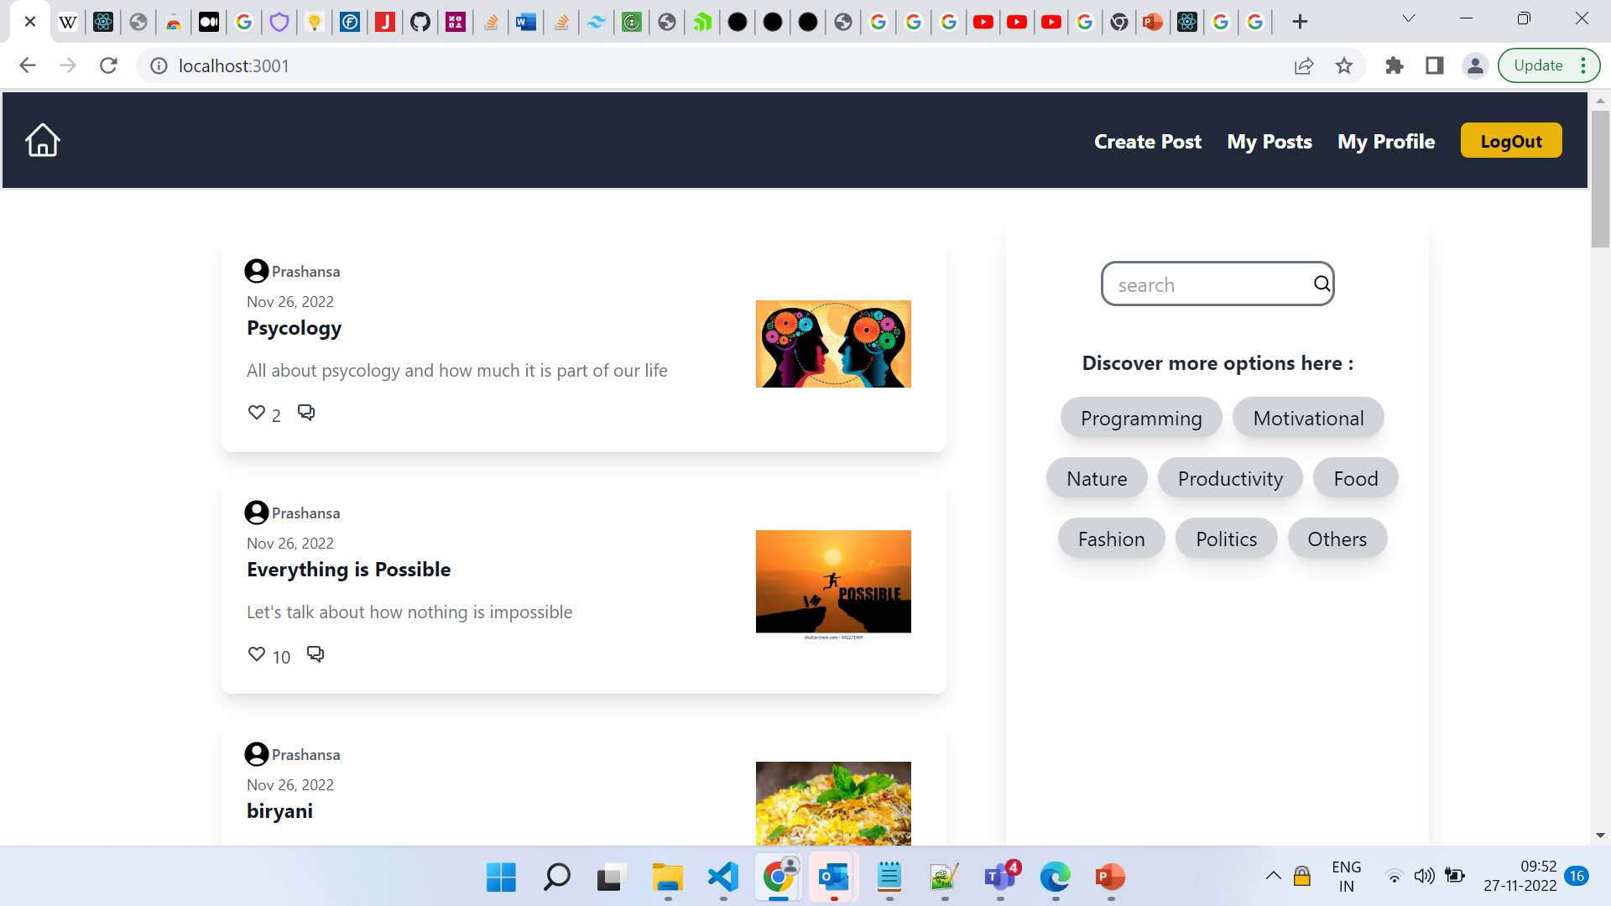
Home Page
Datewise sorted posts
Search button
Filter by categories

Slide 6
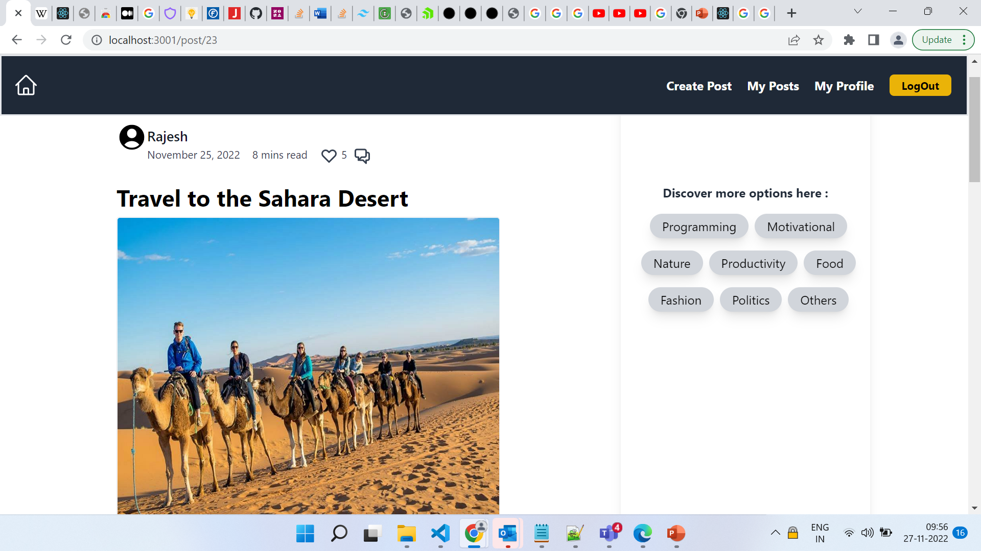
Post Page
applaud
comment

Slide 7
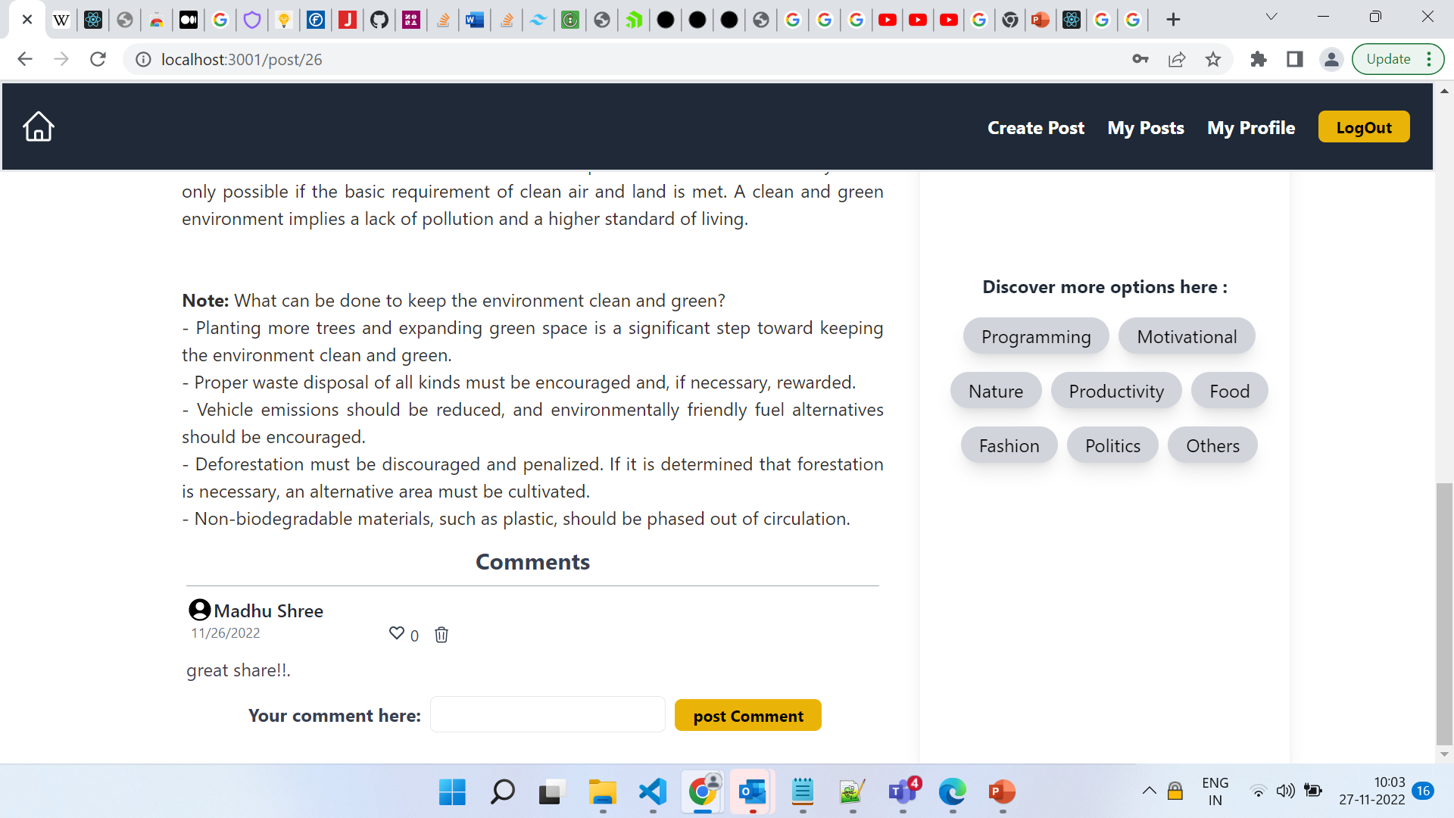
Post Page : comment section
Like Comment
Delete Comment

Slide 8
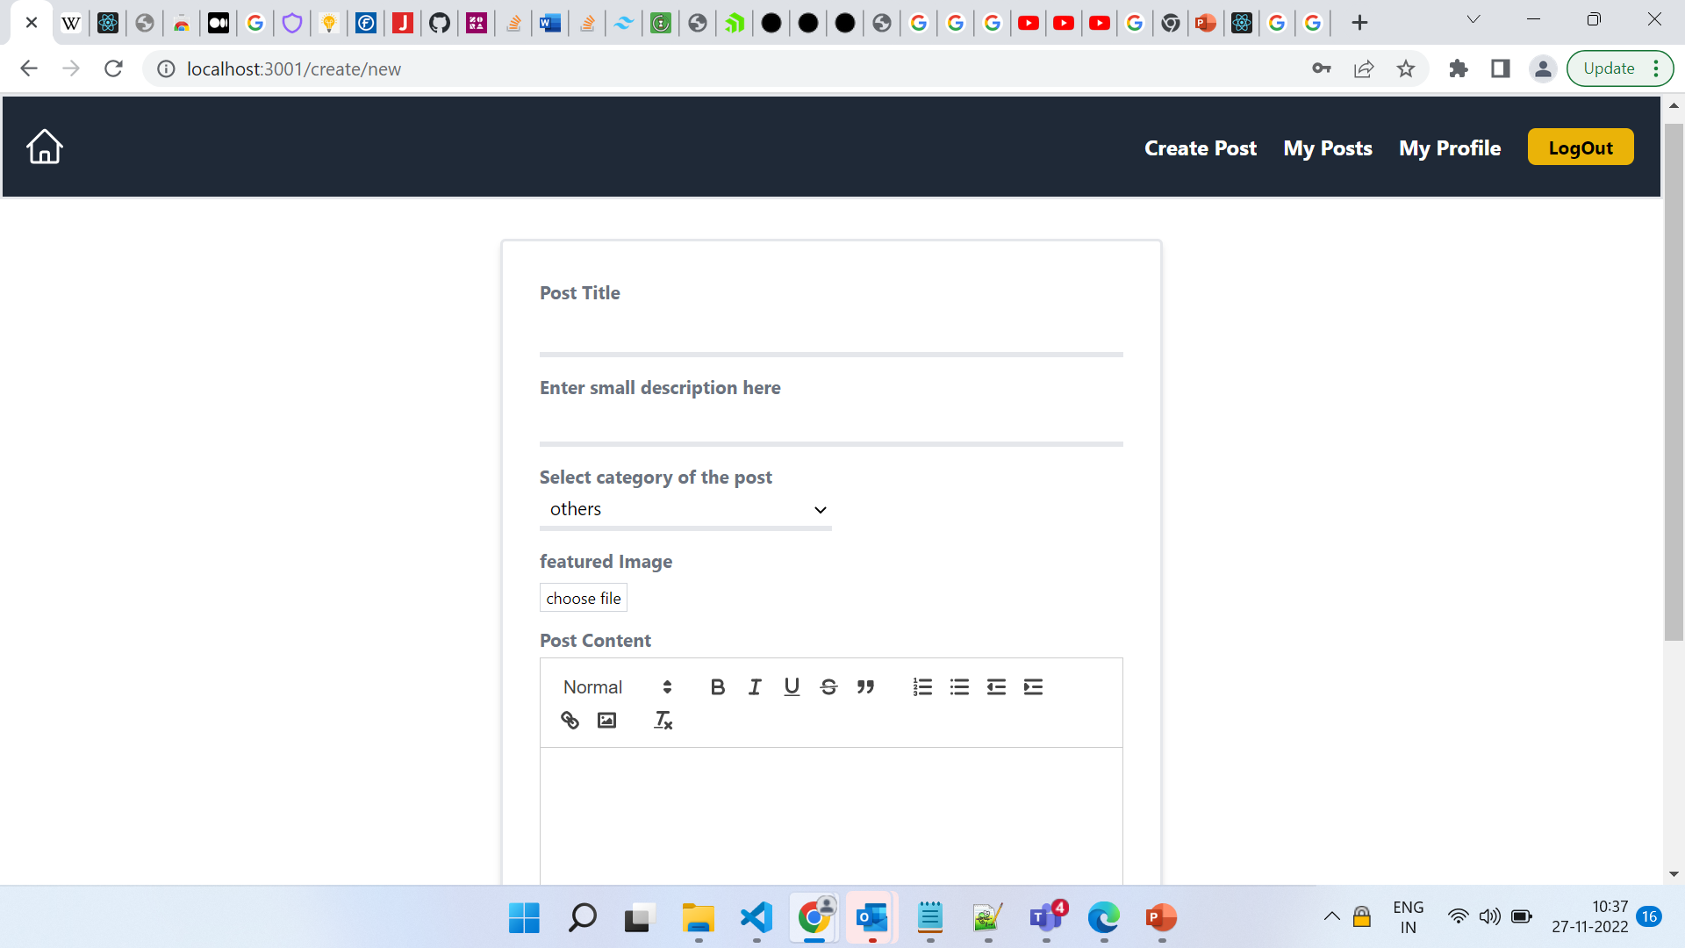
Create Post Form

Slide 9
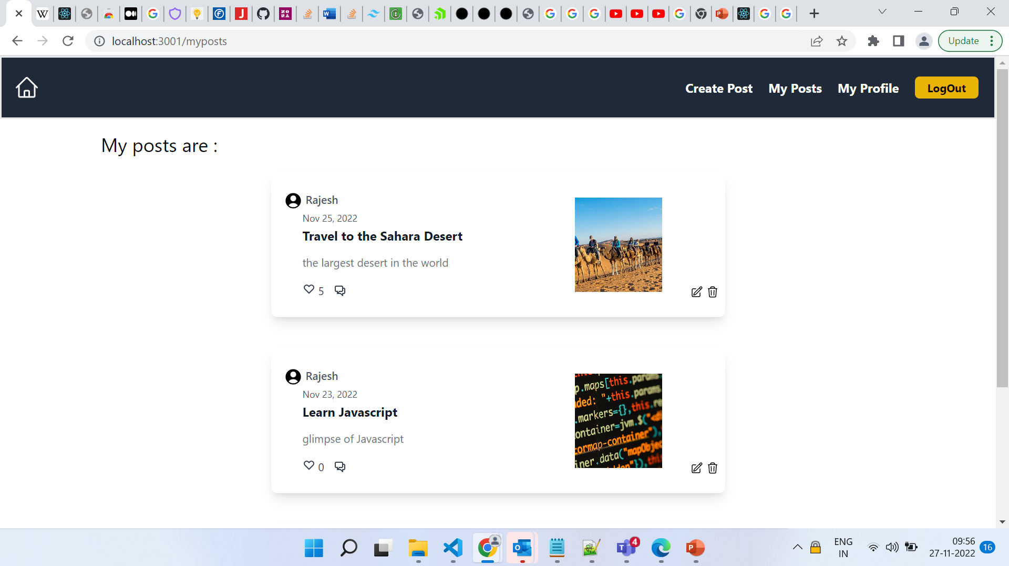
My Posts

Slide 10
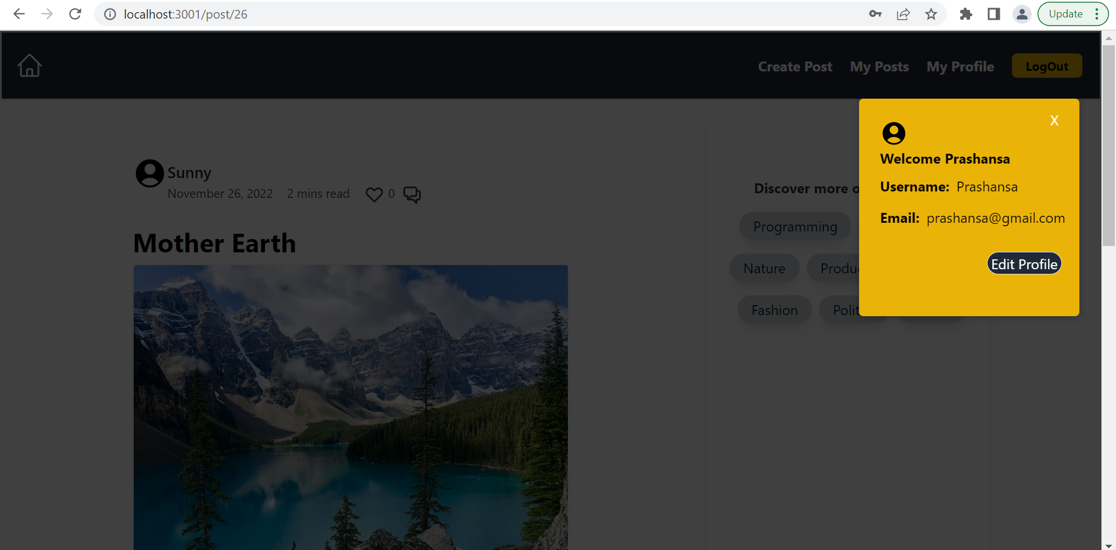
My Profile
Takes to the
Edit
form

Slide 11
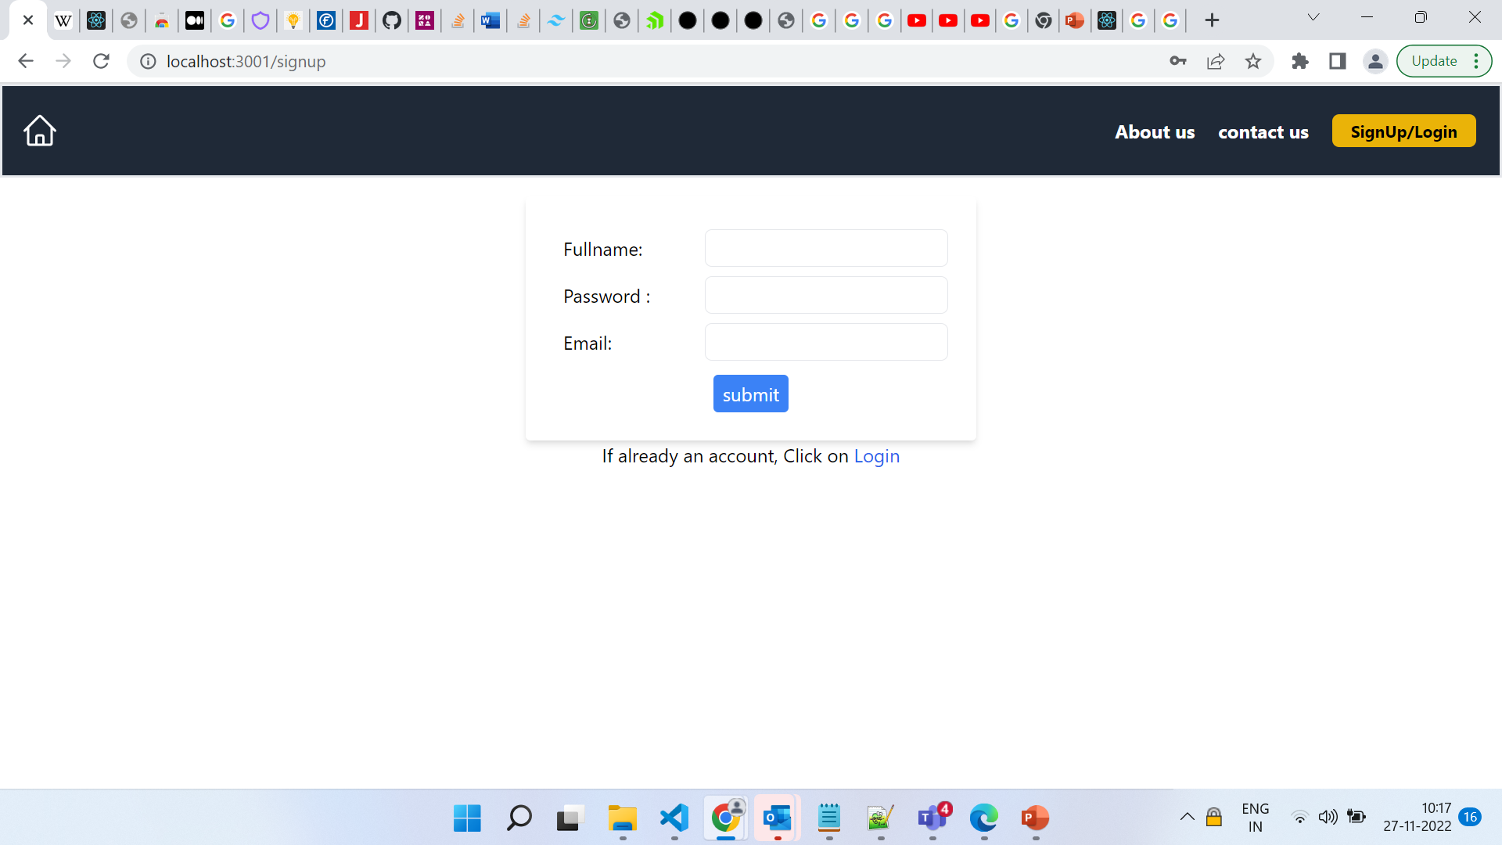
Signup Form

Slide 12
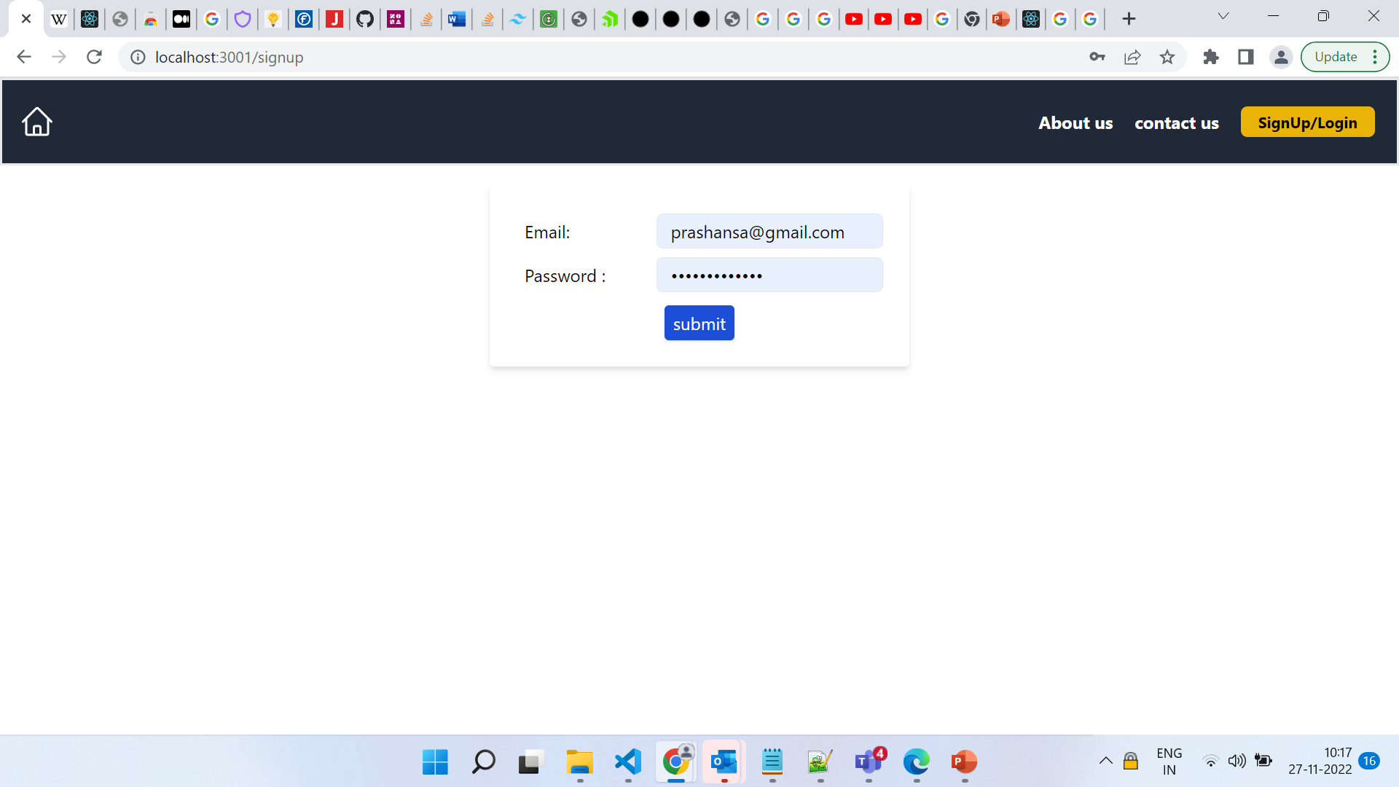
Login Form

Slide 13

Acknowledgement
I would like to express my special thanks of gratitude to our educator Mr. Arjit Verma, as well as ​​and Vijendra Mishra and Mahesh Hegde for helping us through out our journey. And of-course Damini Dutta and Praveen Kumar for the constant support. Lastly gratitude to all my colleagues who helped me to complete this project before timeline.
​

Slide 14

​
Thank You
Prashansa Priya​​
9538046457
prashansa.priya@publicissapient.com

